Slide 1
JavaScript
Things You Never Knew You Didn’t Know
Doug Hughes – Alagad
Notes:
/*
JS Presentation console font size tweaks
place this here: ~/Library/Application Support/Google/Chrome/Default/User StyleSheets/Custom.css
*/
body.platform-mac .monospace, body.platform-mac .source-code {
font-family: Monaco, monospace;
}
/* Keep .platform-mac to make the rule more specific than the general one above. */
body.platform-mac.platform-mac-snowleopard .monospace,
body.platform-mac.platform-mac-snowleopard .source-code {
font-size: 20px !important;
font-family: Menlo, monospace;
}
body.platform-windows .monospace, body.platform-windows .source-code {
font-size: 20px !important;
font-family: Consolas, Lucida Console, monospace;
}
body.platform-linux .monospace, body.platform-linux .source-code {
font-size: 20px !important;
font-family: dejavu sans mono, monospace;
}
.console-group-messages .outline-disclosure, .console-group-messages .outline-disclosure ol {
line-height: normal !important;
}

Slide 2


Deep Thoughts By Donald Rumsfield
Known Knowns | Things you know you know
Known Unknowns | Things you know you don’t know
Unknown Unknowns | Things you don’t know you don’t know

Slide 3
Deep Thoughts By Donald Rumsfield
Known Knowns | Things you know you know
Known Unknowns | Things you know you don’t know
Unknown Unknowns | Things you don’t know you don’t know

Slide 4


Slide 5



2.0
Custom Software Done Right
Solid Process, proven results
100% Cash Back Guarantee
Yes, you read that right
Set Your Own Rate
Yes, you read that right too

Slide 6
JavaScript Is Freakin’ Everywhere!
Desktop Browsers
Desktop Apps
Mobile Browsers
Mobile Apps
TVs
Set Top Boxes
PDFs
Browser extensions
Desktop widgets
Software Suites
Game Engine
More…

Slide 7

Operators

Slide 8
Type Coercion In Equality Operators
== and !=
=== and !==
Works fine when operands are of the same type
If not, it converts types
Can be confusing
Different types are always false
More explicit and less ambiguous

Slide 9
Type Coercion In Equality Operators
== and !=
=== and !==
'' == '0' // false
0 == '' // true
0 == '0' // true
false == 'false' // false
false == '0' // true
false == undefined // false
false == null // false
null == undefined // true
' \t\r\n ' == 0 // true
'' === '0' // false
0 === '' // false
0 === '0' // false
false === 'false' // false
false === '0' // false
false === undefined // false
false === null // false
null === undefined // false
' \t\r\n ' === 0 // false

Slide 10
Numeric Conversions With +
The + operator will convert any value to an integer, if it can
Similar to parseInt() or parseFloat() but more persnickety
+"-12" // -12
+"0xFF" // 255
+new Date() // current timestamp
+"1000" // 1000
+"1,000" // NaN
+true // 1
+false // 2
+"1e10" // 10000000000
Notes:
// Hex to dec conversion:
+"0xFF" // -> 255
// Get a timestamp for now, same as `new Date().getTime()`:
+new Date()
// Safer parsing than parseFloat()/parseInt()
parseInt("1,000") // -> 1
+"1,000" // -> NaN
parseInt("010.010") // -> 8, treated as octal
+"010" // -> 10
// Boolean to integer
+true // -> 1
+false // -> 0
// Other useful tidbits:
+"1e10" // -> 10000000000
+"1e-4" // -> 0.0001
+"-12" // -> -12

Slide 11

Functions

Slide 12
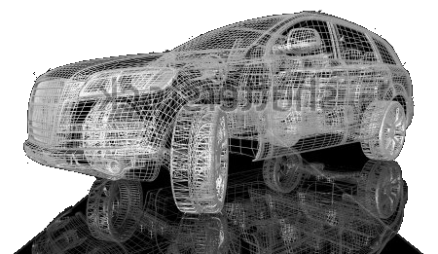
Prototypes and Functions
Adding a function to a prototype adds the same instance of that function to all instances of that object.
You can modify a prototype on the fly and all already-instantiated objects are also modified
Key Point: Functions are objects in JavaScript
This took me a while to fully grok.

Slide 13

Getters and Setters
Can access and manipulate private data.
Can be used to create read-only or set-only properties (more or less)
Car = function(){
var _speed = 0;
this.__defineGetter__("speed", function(){
return _speed;
});
this.__defineSetter__("speed", function(speed){
_speed = speed;
});
};

Slide 14


function.apply(thisArg [, argsArray])
function.call(thisArg, arg1 [, …])
Calls a function with the specified arguments.
Allows you to specify the value of “this”
Similar to apply(), but arguments are expanded and not collected in an array
Useful when you know the number of arguments ahead of time
Used to call a function with an arbitrary number of arguments
Allows you to specify the value of “this”
Useful when you don’t know all the arguments ahead of time
Useful in meta programming
Notes:
Show the apply() and call() example

Slide 15
You Should Note….
ECMAScript Harmony (AKA ECMAScript Next) defined a Proxy() object similar to my example.
If you want to experiment with it, check out https://developer.mozilla.org/en-US/docs/JavaScript/Reference/Global_Objects/Proxy
Notes:
Show the apply() and call() example

Slide 16
Named Anonymous Functions
???????
Notes:
Show the apply() and call() example

Slide 17

Theading

Slide 18
JavaScript’s Event Queue
JavaScript is single threaded!
Timers, interactions, function calls, events, etc, are all added to the Event Queue.
JavaScript’s Event Loop watches for events in the queue and then handles them.
This is why stack traces in JavaScript are so… useless.

Slide 19
JavaScript’s Event Queue Scenario
Action
Event Queue
Event Loop
User loads webpage, causing Load event to fire

Slide 20
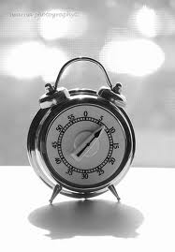
JavaScript’s Event Queue Scenario
Action
Event Queue
Event Loop
onLoad event listener function executed.
Function sets a timer for 30 seconds out.
30 sec

Slide 21
JavaScript’s Event Queue Scenario
Action
Event Queue
Event Loop
User clicks a button
15 sec

Slide 22
JavaScript’s Event Queue Scenario
Action
Event Queue
Event Loop
Click event listener shows an alert box.
User waits 60 seconds before clicking ok.
Blocked!
0 sec

Slide 23
JavaScript’s Event Queue Scenario
Action
Event Queue
Event Loop

Slide 24
JavaScript’s Event Queue Scenario
Action
Event Queue
Event Loop
Timer event handler does it’s thing.
Notes:
Show blocking example of prime finder

Slide 25

Pseudo Threads with setInterval() and setTimeout()
Timers don’t block the page’s thread
When the timer’s event fires it is put into the Event Queue
Event Loop gets to the event when it’s good and ready
Timers are not precise
Notes:
Show psuedo threaded example of non-blocking prime finder

Slide 26

Web Workers
Threading for JavaScript
Does not block the main thread
Worker has no access to DOM or anything not thread-safe
Communication with workers is by passing messages
Worker script must hosted in the same origin as the parent script
Use importScripts() to load required scripts.
Notes:
Show my web worker example.

Slide 27

Arrays

Slide 28

Array Iterative Methods
array.some(callback[, thisObject])
Returns false when callback returns false for all elements in the array, otherwise true
array.every(callback[, thisObject])
Returns true when callback returns true for all elements in the array, otherwise false
array.filter(callback[, thisObject])
Creates new array of values for all elements in array where callback returned true
array.map(callback[, thisObject])
Creates new array of result of calling callback on each element in the arrays
array.forEach(callback[, thisObject])
Calls callback once for each element in the array
/* callback function */
callback = function(value, index, arr){
// your logic
};

Slide 29

Array Reduction
array.reduce(callback[, initialValue])
Iterate over an array from start to end while comparing the current value and the previous value.
array.reduceRight(callback[, initialValue])
Iterate over an array from end to start while comparing the current value and the previous value.
/* callback function */
callback = function(previousValue, currentValue, index, arr){
// your logic
};

Slide 30
Typed Arrays
One of my favorite features right now
Create an array of a known data type:
int8, uint8, int16, uint16, int32, uint32, float32, float64
Must be a known size
Typed arrays use (and can share) an underlying buffer
Undefined elements are 0
Fast!!

Slide 31
Other Things To Check Out
Local Storage
Read and write data locally, but not as cookies
WebSQL
A SQLLite database built right into the browser
Strict Mode
A restricted subset of JavaScript with intentionally different symantics
Named Blocks
You can name blocks of code and use those as targets from break and continue statements
ECMAScript Harmony
The next version of ECMAScript (and JavaScript)
Iterators, Generators, Yield, and Comprehensions
Iterate over objects and generate values (future feature)
Named Anonymous Functions
Useful for recursion
Much, much more
The JavaScript ecosystem is incredibly rich!

Slide 32
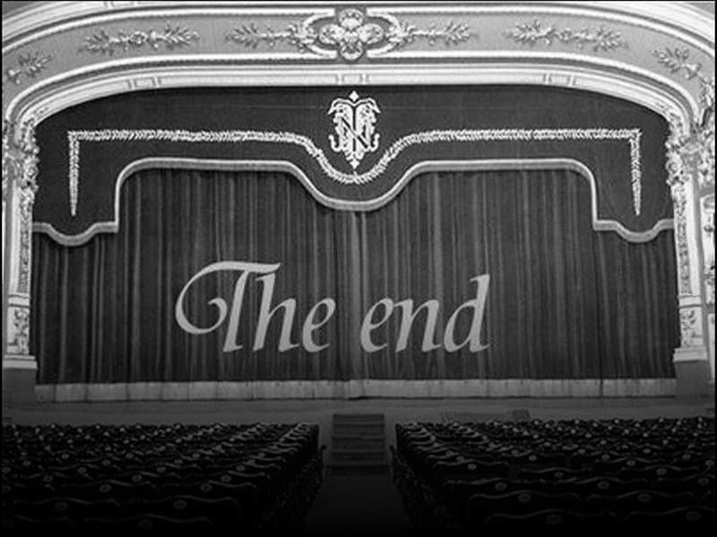
Questions & Answers

